Slide 1
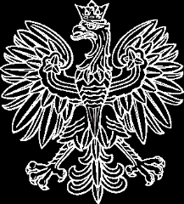
mib.gov.pl
mib.gov.pl
MINISTRY
of INFRASTRUCTURE and CONSTRUCTION
mib.gov.pl
Rail Baltica – E75
Jakub Kapturzak, Railway Department
mib.gov.pl
Riga, April 24, 2017

Slide 2

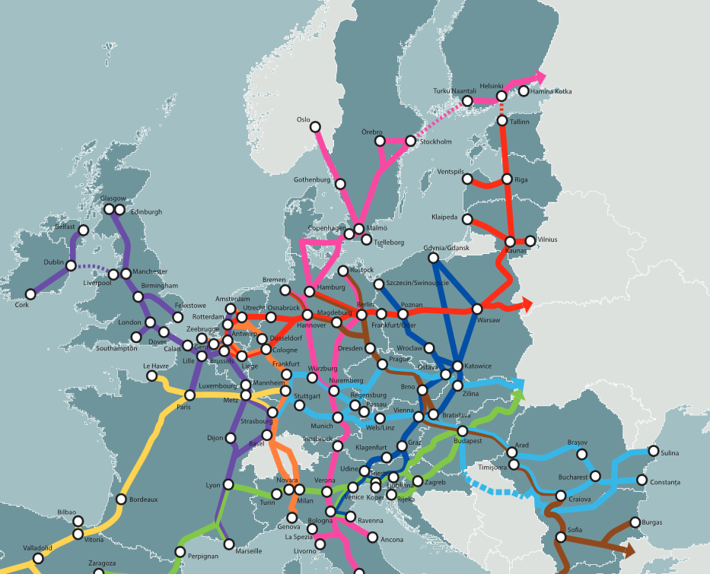
Rail Baltica in the context of Core Network Corridors
MINISTERSTWO
INFRASTRUKTURY
I BUDOWNICTWA
According to the Regulation (EU) No 1316/2013 Rail Baltica is part of Core Network Corridor North Sea – Baltic Sea
Rail Baltica is a key railway transport chain of mixed traffic
The Rail Baltica Line was mentioned in the Action Plan of CNC North Sea - Baltic Sea (Work Plan) among the most important issues for the smooth functioning of the entire corridor and using its potential

Slide 3

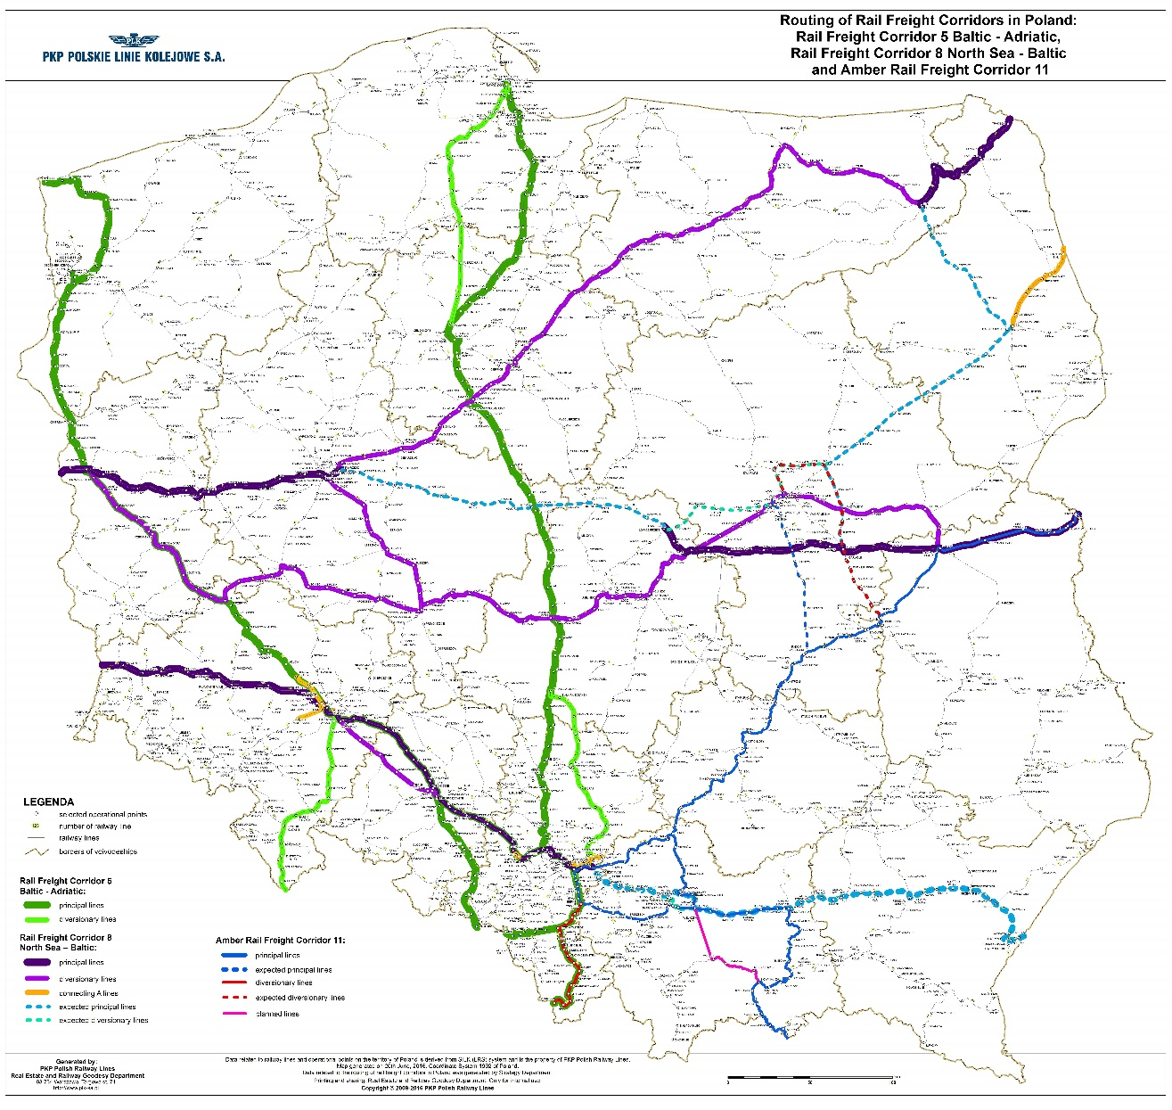
Rail Baltica in the context of rail freight corridor North Sea – Baltic
MINISTERSTWO
INFRASTRUKTURY
I BUDOWNICTWA
Ełk- Trakiszki
Białystok - Ełk
Warszawa - Białystok

Slide 4
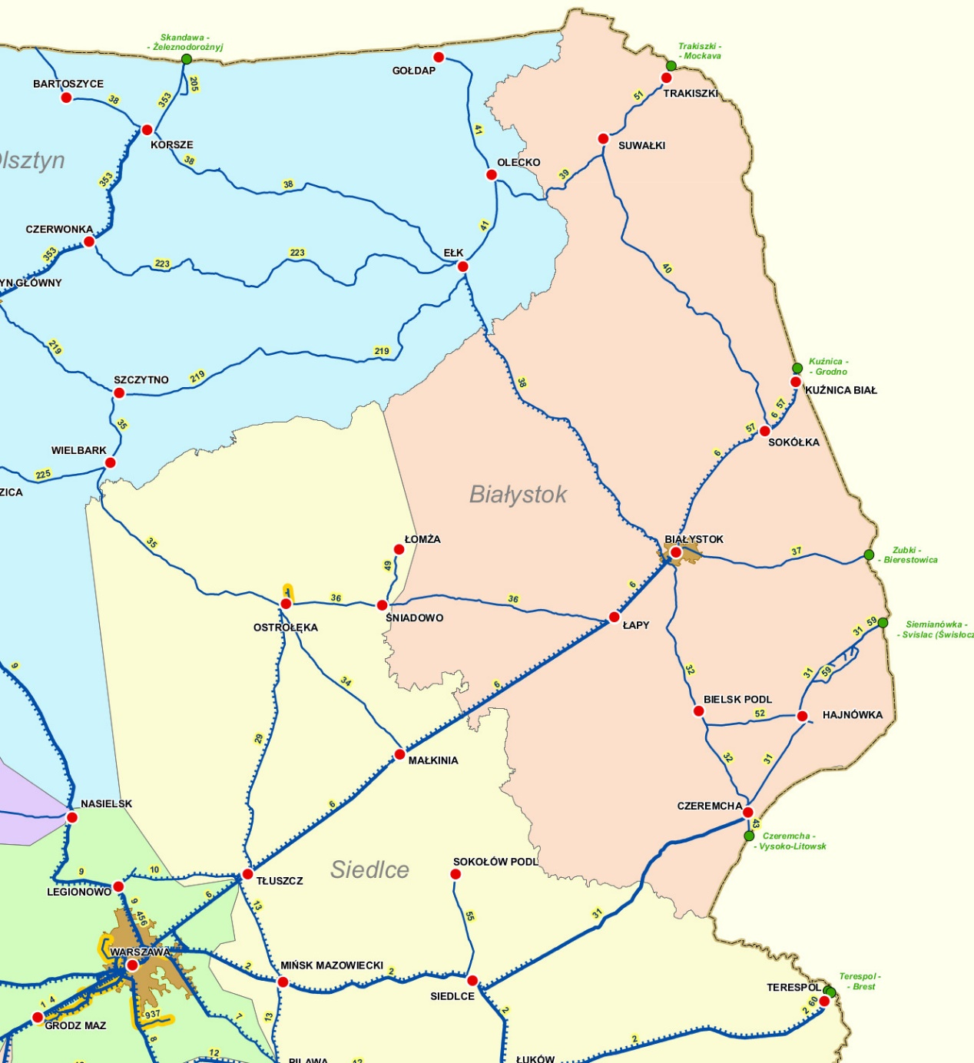
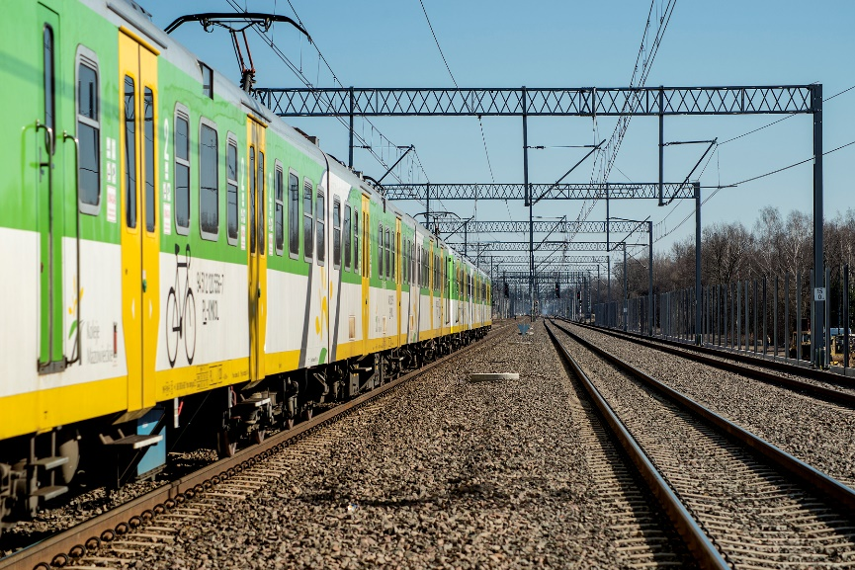
Progress of works on the Rail Baltica line
MINISTERSTWO
INFRASTRUKTURY
I BUDOWNICTWA
 | Modernisation of the railway line E 75 Rail Baltica Warszawa – Białystok – Lithuanian border, stage I, section Warszawa Rembertów – Zielonka – Tłuszcz (Sadowne) Phase II | Ongoing (end of works – May 2017) Approx. EUR 325 m | Designing and installation of ETCS on the section Warszawa Rembertów – Białystok planned for the years 2021 – 2023.
 | Works on the section Sadowne – Czyżew of the E 75 line along with other works on the Warszawa Rembertów – Sadowne section | Preparation of detailed design is ongoing. Realisation of works planned for the years 2017-2020. Approx. EUR 240 m
 | Works on the section Czyżew – Białystok of the E 75 line | Project documentation is in the process of preparation. Execution of works planned for the years 2017-2021. Approx. EUR 393 m

Slide 5
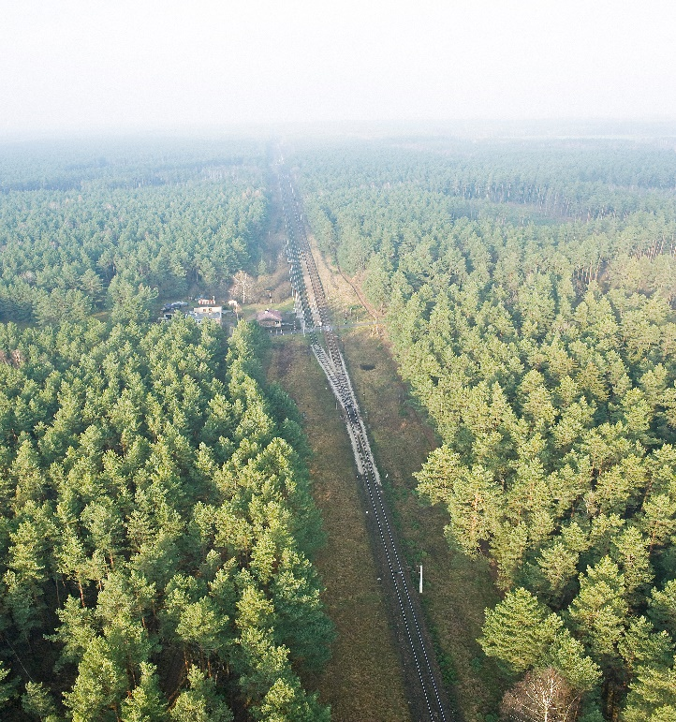
Progress of works on the Rail Baltica line
MINISTERSTWO
INFRASTRUKTURY
I BUDOWNICTWA
 | Works on the railway line E 75 on the section Białystok – Suwałki – Trakiszki (state border), stage I section Białystok - Ełk | Preparation of results of feasibility study is completed. An application for funding under the third CEF call has been submitted on 6th of February 2017. Execution of works planned for the years 2020 – 2023. Approx. EUR 395 m | The ERTMS/ETCS installation within the project.
 | Works on the railway line on the section Białystok – Suwałki – Trakiszki (state border), Ełk – Trakiszki section | Feasibility study is completed (120/140 kph variant). Application for EU funds is planned. Approx. EUR 420-600 m | Realisation of ERTMS/ETCS installation will be analysed in addition to the feasibility study.
Altogether approx.
EUR 1.76 – 1.94 bn

Slide 6
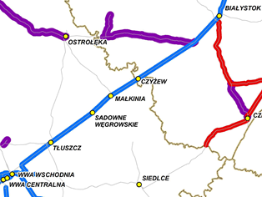
Modernization of E 75 Rail Baltica Warszawa – Białystok – state border with Lithuania, stage I, Warszawa Rembertów – Zielonka – Tłuszcz (Sadowne) section; Phase II
Works on E 75 at Sadowne – Czyżew section, along with other works at Warszawa Rembertów – Sadowne section
(financing: OPI&E, CEF)
MINISTERSTWO
INFRASTRUKTURY
I BUDOWNICTWA
Basic parameters (currently):
Double track line, electrified;
Length of the section 66 km (Warszawa – Sadowne), 36 km (Sadowne – Czyżew);
Maximum speed:
Axle load 221 kN.
Speed | % of length (passenger trains)
160 | 59
120 | 41
Speed | % of length (freight trains)
120 | 59
100 | 7
80 | 34
CHARACTERISTICS OF THE INVESTMENT
Continuation of works on Warszawa – Białystok line. The works began in the EU 2007 – 2013 financial perspective.
End of works: May 2017 (Warszawa-Sadowne), 2020 (Sadowne-Czyżew)
Most important problems affecting the section:
Technical condition of track superstructure, making it impossible to raise the speed;
Technical condition of engineering structures.
Investment aims at modernization and includes:
Raising the speed to 160 kph for passenger trains and 120 kph for freight trains;
Adjusting traffic control systems for cooperation with ERTMS/ETCS;
Reconstruction of track superstructure and track substructure, engineering structures and catenary;
Construction of a new bridge over Bug river and the second track on Prostyń Bug – Małkinia section;
The project: Works on E 75 at Sadowne – Czyżew section, along with other works at Warszawa Rembertów – Sadowne section was positively evaluated in the first call of CEF and the Grant Agreement was signed.

Slide 7
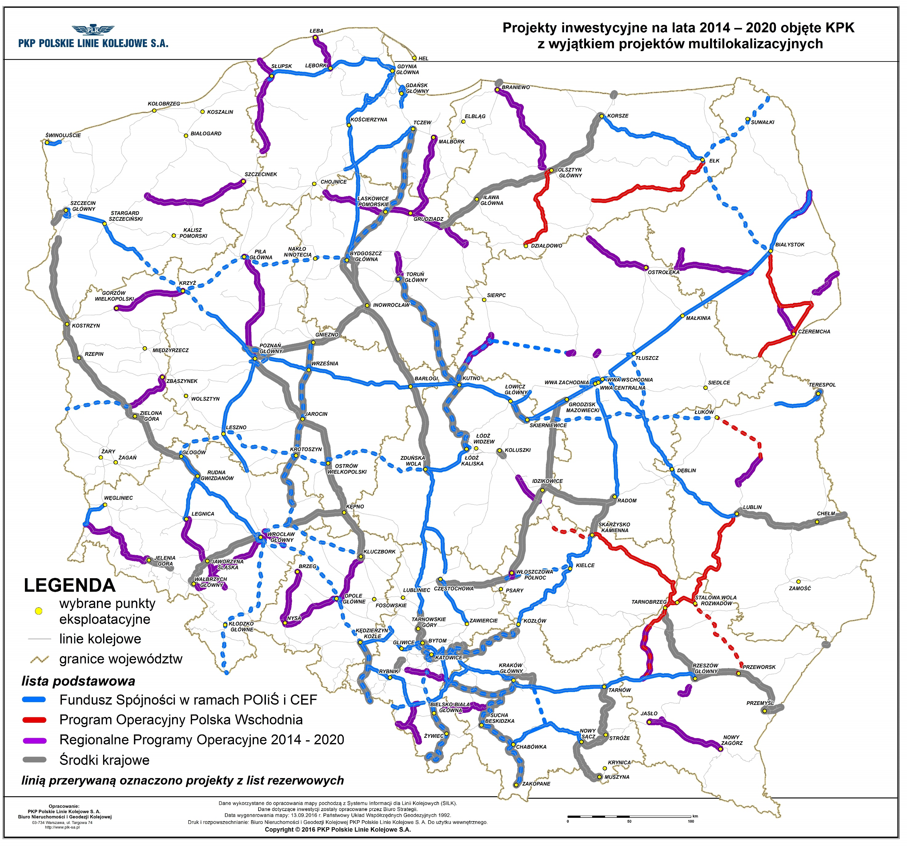
Works on E 75 line at Czyżew – Białystok section
MINISTERSTWO
INFRASTRUKTURY
I BUDOWNICTWA
Basic parameters (currently):
Double track line, electrified;
Length of the section 72 km;
Maximum speed:
Axle load 205 kN.
Speed | % of length
120 | 66
100 | 34
CHARACTERISTICS OF THE INVESTMENT
Most important problems affecting the section:
Technical condition of track superstructure, making it impossible to raise the speed;
Axle load below 221 kN;
No possibility to handle trains with a length of 740 m;
Technical condition of engineering structures.
Investment aims at modernization and includes:
Raising the speed to 160 kph for passenger trains and 120 kph for freight trains;
Increasing axle load limit to 221 kN;
The project was positively evaluated in the second call of CEF and the Grant Agreement was signed.
End of works: 2021

Slide 8
Works on E 75 line at Białystok – Ełk section
MINISTERSTWO
INFRASTRUKTURY
I BUDOWNICTWA
Basic parameters (currently):
Line electrified, single track;
Length of the section ca. 105 km;
Maximum speed:
Local speed limits to 20 – 50 km/h;
Axle load 205 - 206 kN (221 kN on line no 38).
Speed | % of length (passenger trains) | Speed | % of length (freight trains)
120 | 15 | 100 | 18
100 | 85 | 100 | 82
Evolution of analysed variants
Speed Number of tracks
160 km/h 2
120/140 km/h 1 or 2 tracks on different parts
CHARACTERISTICS OF THE INVESTMENT
Most important problems affecting the section:
Technical condition of track superstructure;
Technical condition of engineering structures.
Investment aims at modernization and includes:
Construction of the second track at Białystok – Ełk section (on line no 38);
Adjusting technical infrastructure to the speed of 160 kph for passenger traffic and to 100 kph for freight traffic;
Increasing axle load limits to 221 kN;
Enabling operation of trains with a length of 740 m;
Fulfilling demands indicated in Directive 2008/57/EC of the European Parliament and of the Council of 17 June 2008 on the interoperability of the rail system within the Community, along with regulations and decisions of the EC;
Increasing the efficiency of traffic control system.
The application under the third CEF call has been submitted (submission date: 6.02.2017). End of works: 2023

Slide 9
Works on E 75 line at Ełk – Trakiszki section
MINISTERSTWO
INFRASTRUKTURY
I BUDOWNICTWA
Basic parameters (currently):
Line not electrified, single track;
Lenght of the section approx. 100 km;
Maximum speed:
Axle load 205 kN.
Speed | % of length (bus-trains)
80 | 28%
60 | 35%
50 | 16%
40 | 21%
30 | –
Speed | % length (passenger and freight trains)
80 | 26%
60 | 34%
50 | 17%
40 | 2%
30 | 21%
CHARACTERISTICS OF THE INVESTMENT
Most important problems affecting the section:
Technical condition of track superstructure and of engineering structures, which prevents from raising the speed;
Low axle load.
Investment aims at modernization and includes:
Construction of another track on Ełk – Trakiszki section and construction of Olecko and Suwałki bypasses;
Electrification;
Adjusting technical infrastructure to the speed of 120/140 kph for passenger traffic and to 100 kph for freight traffic or adjustment to
v= 160 kph which would require a new pre-design documentation;
Enabling operation of trains with a length of 740 m;
Fulfilling demands indicated in Directive 2008/57/EC of the European Parliament and of the Council of 17 June 2008 on the interoperability of the rail system within the Community, along with regulations and decisions of the EC;
Increasing the efficiency of traffic control system.
EU funding is needed.

Slide 10
Works on railway line E 75 – section Ełk – Trakiszki
v=140 km/h vs. v=160 km/h variants
MINISTERSTWO
INFRASTRUKTURY
I BUDOWNICTWA
Parameter | Variant v=140 km/h | Variant v=160 km/h
Travel time Warszawa Centralna – Trakiszki | approx. 193 min | approx. 181 min
Travel time Ełk – Trakiszki | approx. 50 min | approx. 38 min
Cost Ełk - Trakiszki | approx. PLN 1.8 bn EUR 420 m | approx. PLN 2.6 bn EUR 600 m
Announcement of tendering on feasibility study | IIIQ 2014 | IIQ 2017
Possible decision on variant in the feasibility study | IIIQ 2016 / IQ 2017 (after correction) | IIIQ 2018
Environmental Impact Assessment | IIQ 2015 – IIQ 2016 | IIIQ 2017 – IVQ 2018
Environmental decision | IVQ 2018 | IQ 2020
Construction projects | IVQ 2019 | IIQ 2021
Completion of construction works | IIQ 2023 | IVQ 2024
Start of use along with ERTMS / ETCS | IIQ 2024 | IVQ 2025
Risks | No CEF funding Low risk of protests at the stage of obtaining administrative decisions | No CEF funding High risk of protests at the stage of obtaining administrative decisions Long time for land acquisition

Slide 11


Environmental conditions
MINISTERSTWO
INFRASTRUKTURY
I BUDOWNICTWA
Rail Baltica on the Białystok – Suwałki – Trakiszki – State Border section adjoins to or crosses the following protected areas:
Wigierski National Park: railway line 51 on a section Suwałki–state border – the line neighbours the border’s buffer zone.
Biebrzański National Park: line is adjacent to the border of BPN on 1,3 km (total length); crosses the BPN on a section of 1,35 km.
Natura 2000 Dolina Biebrzy PLH200008: line crosses the area on a section of 12,500 km.
Natura 2000 Ostoja Biebrzańska PLB200006: line crosses the area on a section of 19,625 km.
Natura 2000 Ostoja Augustowska PLH200005: line crosses the area on a section of approx. 0,9 km.
Natura 2000 Puszcza Augustowska PLB200002: line crosses the area on a section of approx. 0,9 km.
The line runs in direct vicinity of Natura 2000 areas:
Ostoja Narwiańska, Dolina Górnej Rospudy

Slide 12
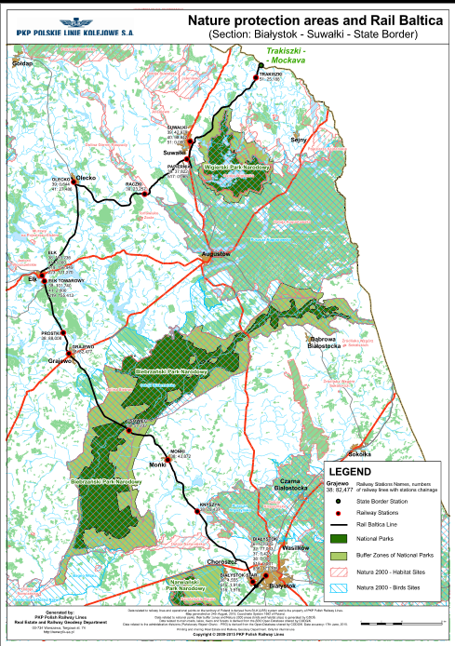
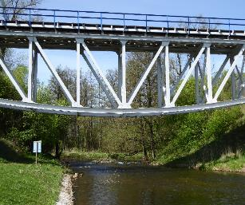
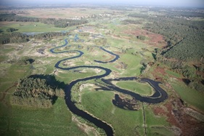
Environmental conditions
MINISTERSTWO
INFRASTRUKTURY
I BUDOWNICTWA
Bridge on km 24,475 LK 39
Biebrzański National Park

Slide 13
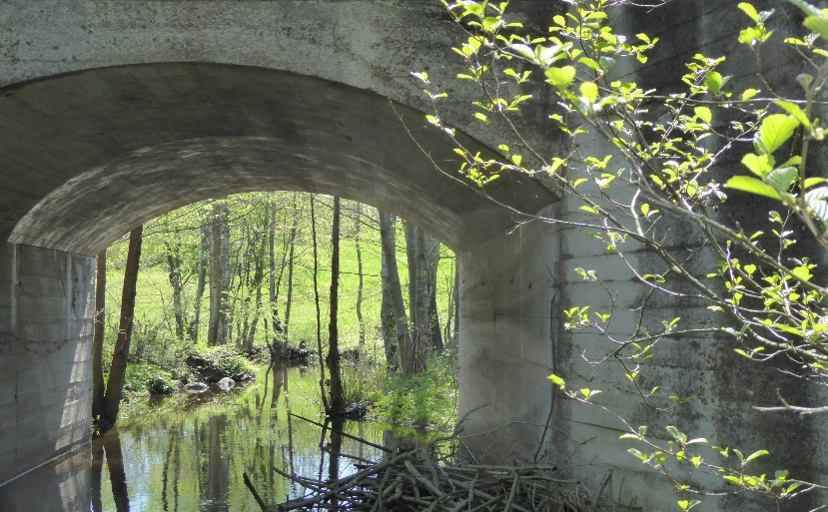
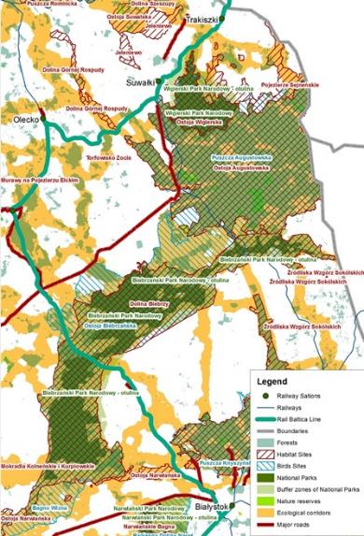
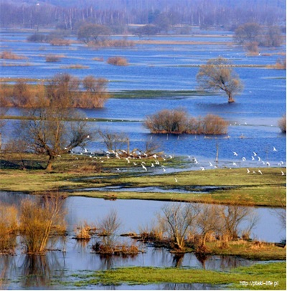
Environmental conditions
MINISTERSTWO
INFRASTRUKTURY
I BUDOWNICTWA
Bridge on km 14,612 lk 51
Legenda
Stacje
Linie kolejowe inne
Linia E 75
Granice
Lasy
Obszary chronione
Siedliska ptaków
Parki Narodowe
Otuliny Parków Narodowych
Rezerwaty przyrody
Korytarze ekologiczne
Biebrzański National Park
Główne drogi

Slide 14
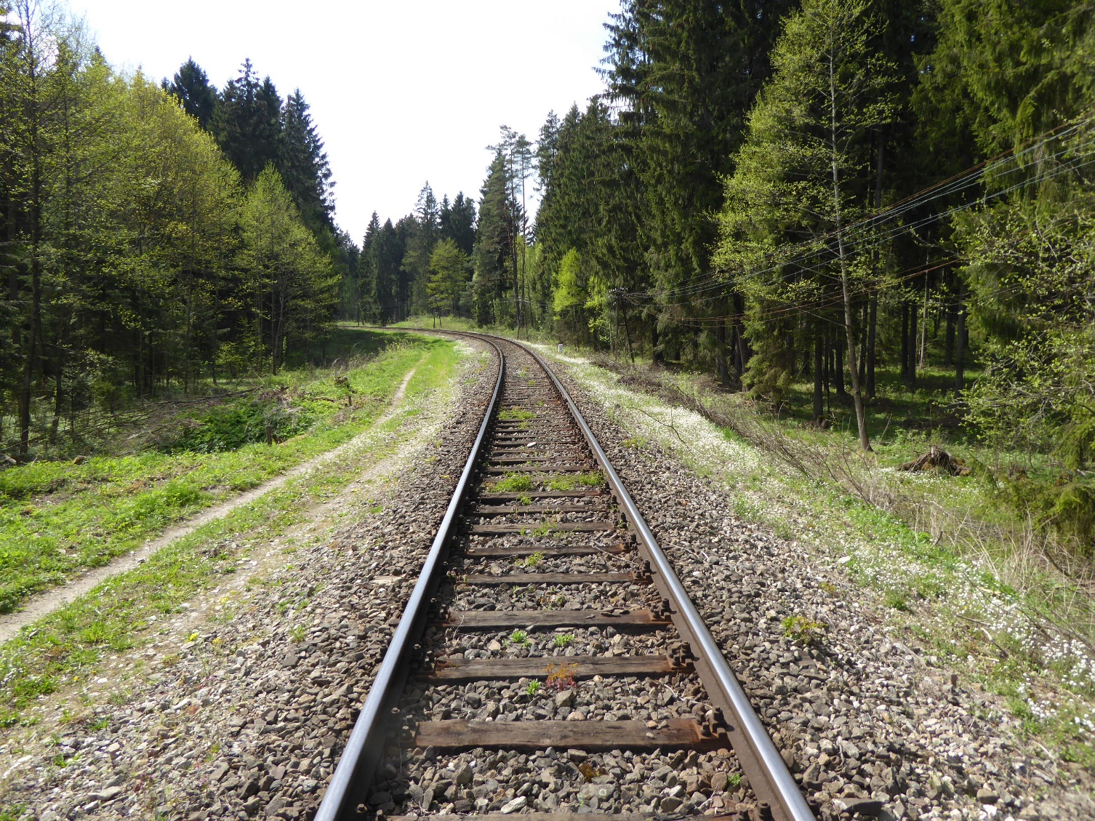
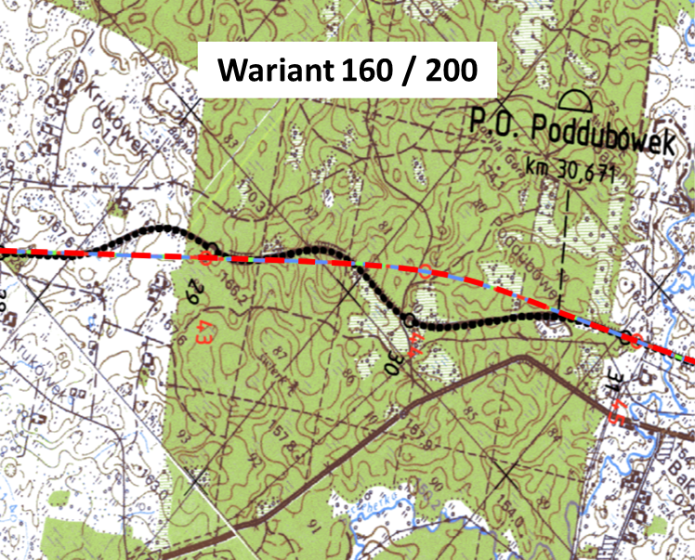
Works on the E 75 railway line on the Ełk - Trakiszki section Routing and environmental considerations: Ełk - Suwałki
MINISTERSTWO
INFRASTRUKTURY
I BUDOWNICTWA
v= 120/140 variant
possible v=160 routing
Legenda
Stacje
Linie kolejowe inne
Linia E 75
Granice
Lasy
Obszary chronione
Siedliska ptaków
Parki Narodowe
Otuliny Parków Narodowych
Rezerwaty przyrody
Korytarze ekologiczne
Główne drogi

Slide 15
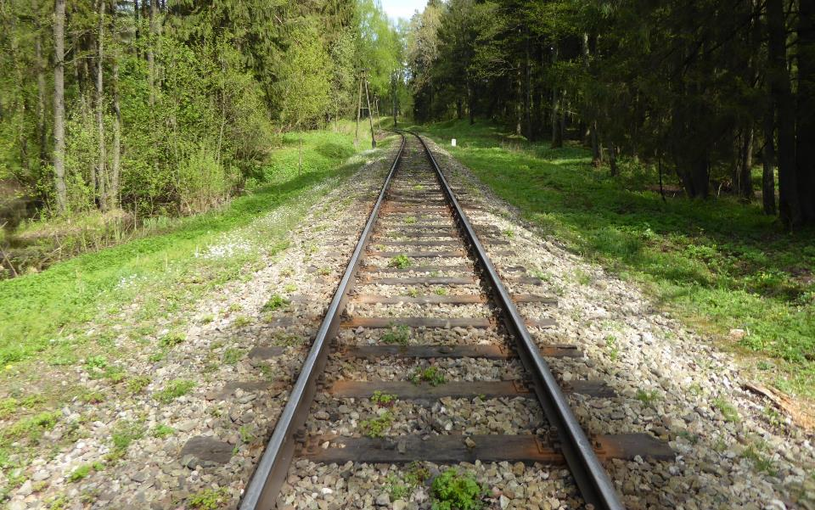
Works on the E 75 railway line on the Ełk - Trakiszki section Routing and environmental considerations: Ełk - Suwałki
MINISTERSTWO
INFRASTRUKTURY
I BUDOWNICTWA

Slide 16
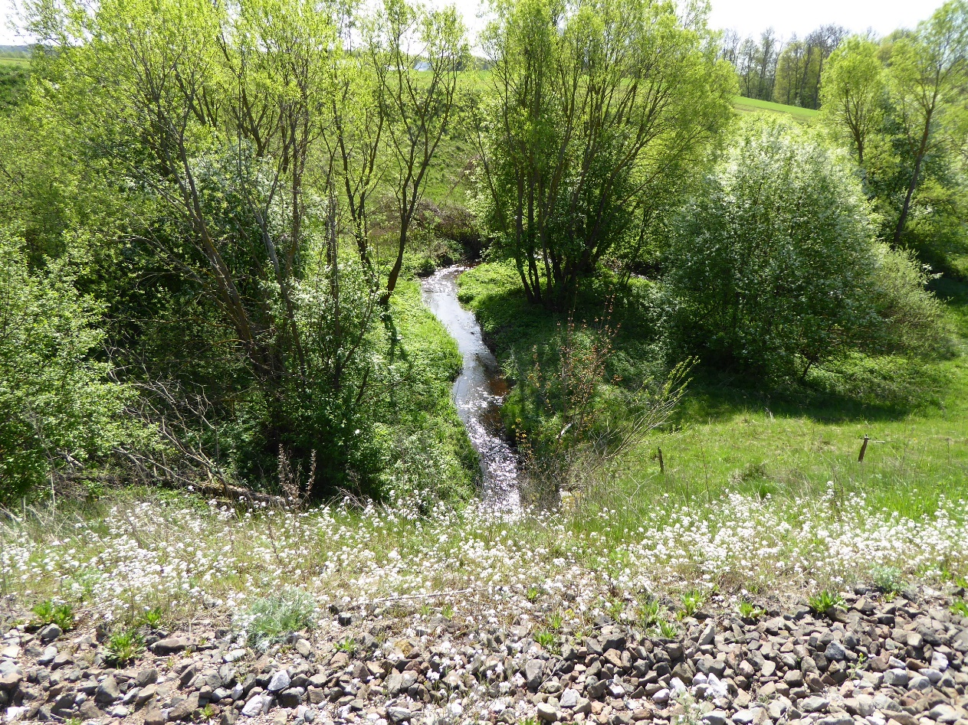
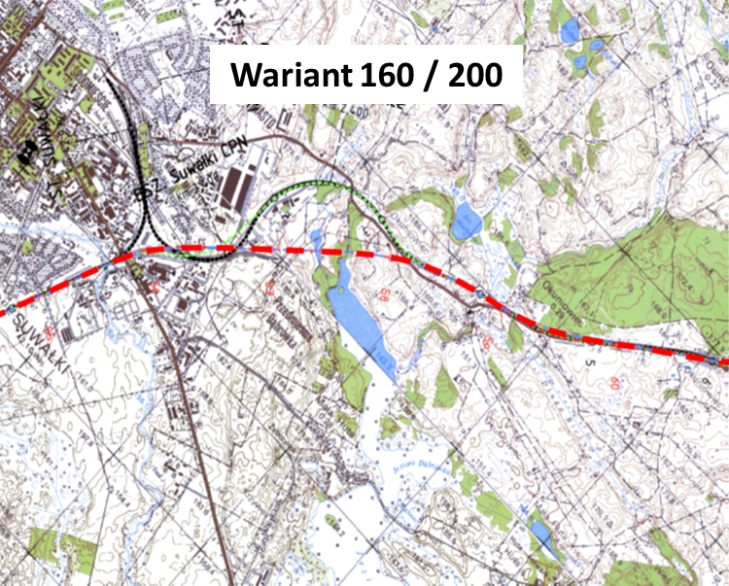
Works on the E 75 railway line on the Ełk - Trakiszki section Routing and environmental considerations: Suwałki area
MINISTERSTWO
INFRASTRUKTURY
I BUDOWNICTWA
LK 51 km 10,504
v=120/140 variant
possible v=160 routing
Legenda
Stacje
Linie kolejowe inne
Linia E 75
Granice
Lasy
Obszary chronione
Siedliska ptaków
Parki Narodowe
Otuliny Parków Narodowych
Rezerwaty przyrody
Korytarze ekologiczne
Główne drogi

Slide 17
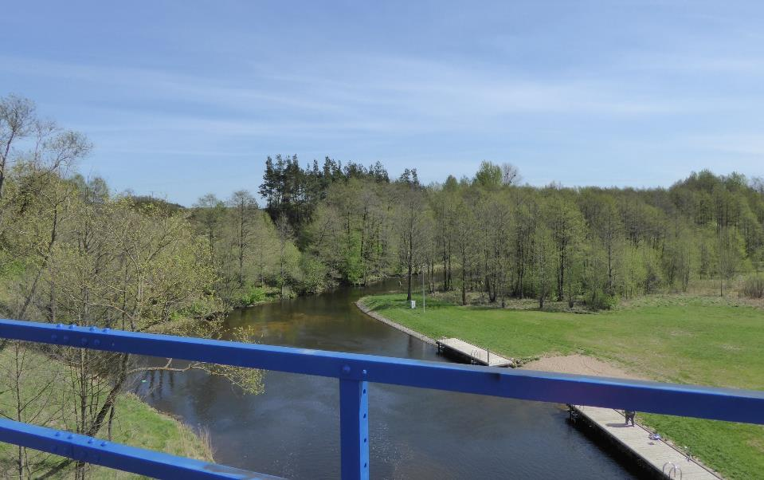
Works on the E 75 railway line on the Ełk - Trakiszki section Routing and environmental considerations: Suwałki area
MINISTERSTWO
INFRASTRUKTURY
I BUDOWNICTWA

Slide 18
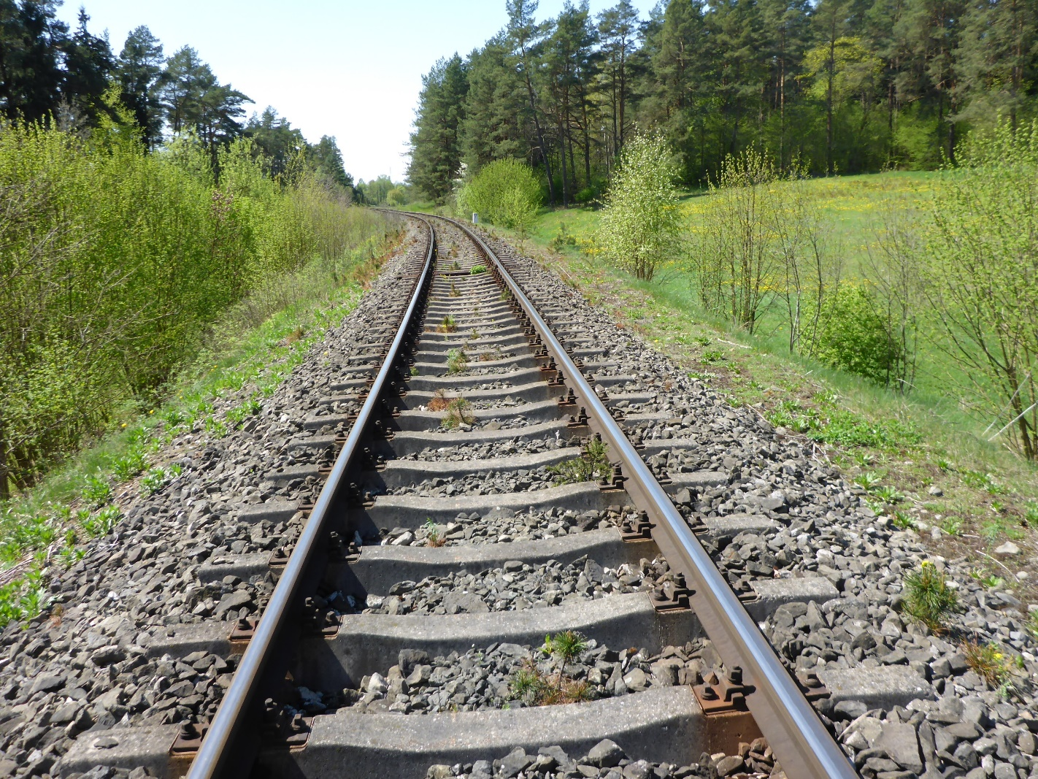
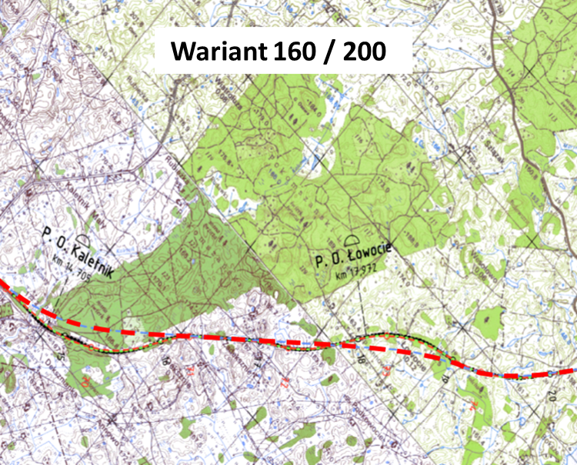
Works on the E 75 railway line on the Ełk - Trakiszki section Routing and environmental considerations: Suwałki - Trakiszki
MINISTERSTWO
INFRASTRUKTURY
I BUDOWNICTWA
v=120/140 variant
Environmentally unfriendly possible v=160 routing
Legenda
Stacje
Linie kolejowe inne
Linia E 75
Granice
Lasy
Obszary chronione
Siedliska ptaków
Parki Narodowe
Otuliny Parków Narodowych
Rezerwaty przyrody
Korytarze ekologiczne
Główne drogi

Slide 19
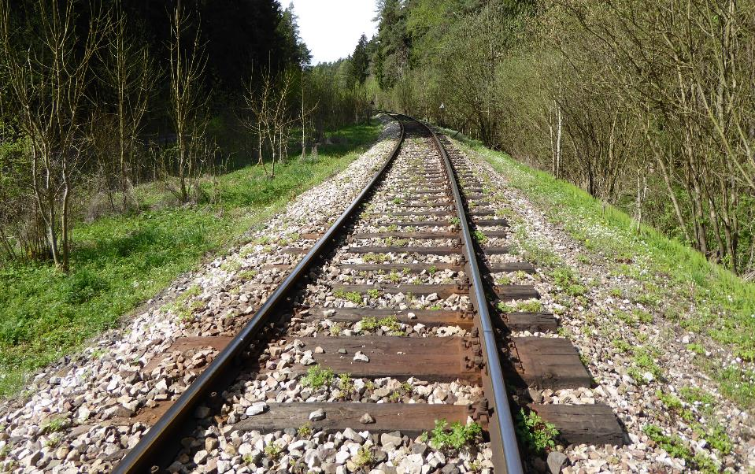
Works on the E 75 railway line on the Ełk - Trakiszki section Routing and environmental considerations
MINISTERSTWO
INFRASTRUKTURY
I BUDOWNICTWA

Slide 20

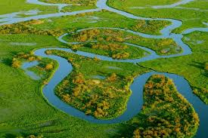
Environmental conditions
MINISTERSTWO
INFRASTRUKTURY
I BUDOWNICTWA
Biebrzański National Park
Rail Baltica adheres to the Park’s border from app 58,250 km up to app. 58,500 km; it crosses the Park from app. 58,500 up to app. 59,850 km and then again adheres to the Park from app. 59,850 km to app. 60,900 km.
It is the biggest national park in Poland, protecting the natural character of Biebrza river and its swamps and peatbogs. One of the most precious in Europe refuges of wetland avifauna. The area is included in the Ramsar Convention.

Slide 21
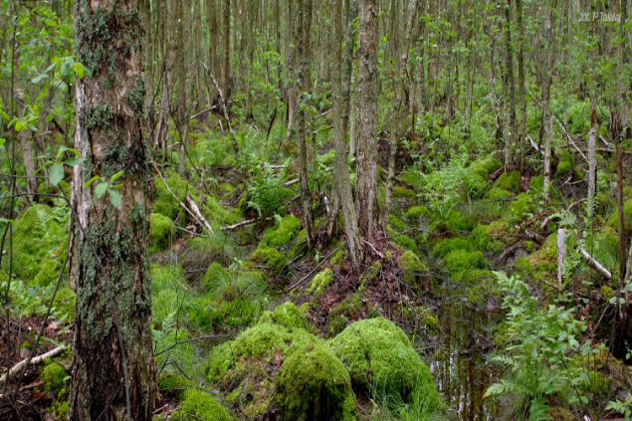
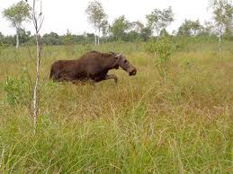
Environmental conditions
MINISTERSTWO
INFRASTRUKTURY
I BUDOWNICTWA
Natura 2000 Site Dolina Biebrzy (Biebrza Valley) PLH200008
Rail Baltica crosses the site from app. 54,725
to km up to 67,225 km.
One of the last wildlife refuges in Europe. Covered by marshes, peatbogs and swamp sites. 15 types of habitats from the Habitats Directive were identified. The biggest share of intermediate mires and swamps. Birds refuge at the European scale. Precious corridor of wildlife migration.

Slide 22
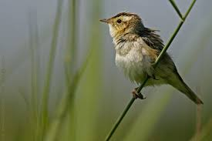
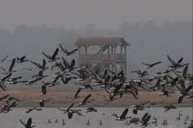
Environmental conditions
MINISTERSTWO
INFRASTRUKTURY
I BUDOWNICTWA
Natura 2000 Site Ostoja Biebrzańska (Biebrza Refuge) PLB 200006
Rail Baltica crosses the site from app. 54,725 km up to app. 74,350 km.
One of the biggest Natura 2000 sites in Poland, preserves extended areas of open swamps. In the refuge at least 43 species from Annex I of Birds Directive were found. The biggest refuge of aquatic warblers and greater spotted eagles in Europe.

Slide 23
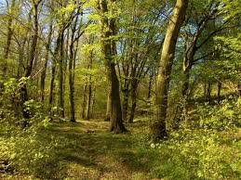
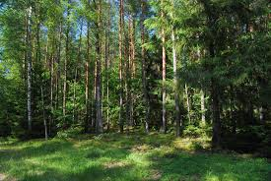
Environmental conditions
MINISTERSTWO
INFRASTRUKTURY
I BUDOWNICTWA
Natura 2000 Site Ostoja Augustowska (Augustów Refuge) PLH200005
Rail Baltica crosses the site from app. 37,520 km up to app. 38,480 km.
One of the biggest and the best preserved forests in Europe, 10 species of animals and 7 species of plants from the Annex II of Habitats Directive. Types of forest sites from Annex I of this Directive cover 12 % of this area. An important corridor of wildlife migration.

Slide 24
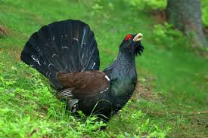
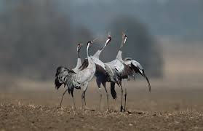
Environmental conditions
MINISTERSTWO
INFRASTRUKTURY
I BUDOWNICTWA
Natura 2000 Area Puszcza Augustowska (Augustów Primeval Forest) PLB200002
Rail Baltica crosses the site from app. 37,520 km up to app. 38,480 km.
The site includes the territory in 90% covered by natural tree stand with domination of moist and swampy forests. 40 species of birds from the Annex I of Birds Directive live there. The area important for maintaining the western capercaillie, lesser spotted eagles, snake eagles, woodpeckers and cranes.

Slide 25
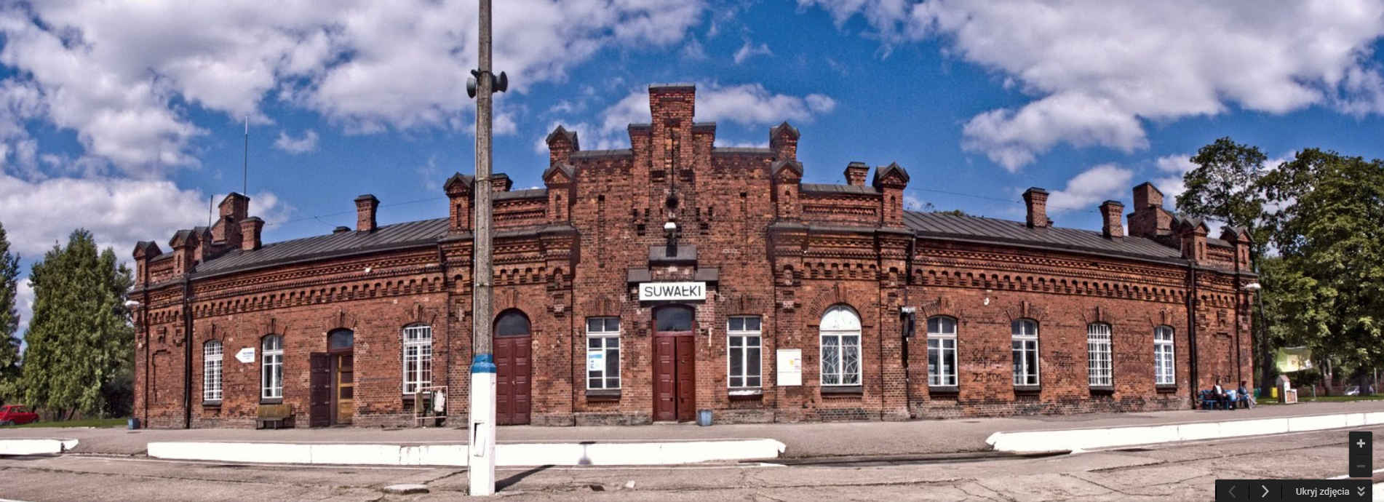
Works on the E 75 railway line on the Ełk - Trakiszki section
MINISTERSTWO
INFRASTRUKTURY
I BUDOWNICTWA

Slide 26
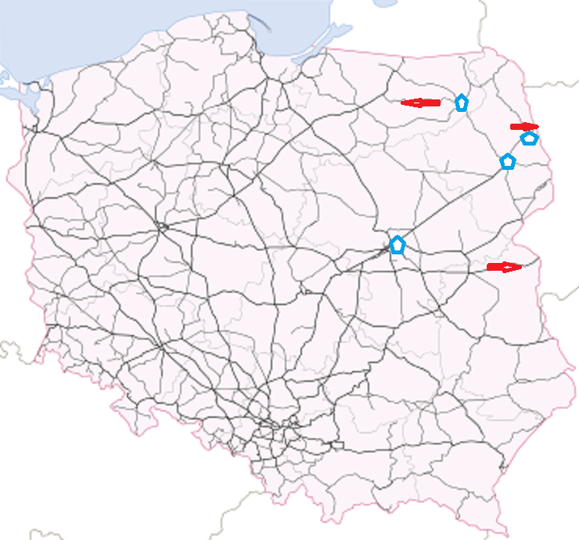
Terminals and prospects for future infrastructure
MINISTERSTWO
INFRASTRUKTURY
I BUDOWNICTWA
Warsaw is currently the most important location in hubs, intermodal terminals for railway transport.
In Białystok there is now more then 20 terminals and depots, there terminals in Kuźnica Białostocka and Sokółka and near the border with Kaliningrad area but these one are not to facilitate trade with Baltic States.
With the RB routing through Ełk the project is connected with Polish harbours of Tricity.

